Slide 1
TEAM (13)
Mahmoud Shaban Abd_ELwadoud
Mahmoud Ahmed Saudi
Mahmoud Ashraf Rashid
Mohamed Ehab Hassan Sayed

Slide 2

C PROGRAMMING LANUAGE

Slide 3
The origin and history of the language
The C language was designed at Bell Laboratories between 1972 and 1973.
Because a large part of C, and so called a large part of it, was borrowed from the B language.
This has evolved and the language has evolved to the point where it is powerful enough to convert the Unix kernel from assembly language to C.
C is considered a powerful language and one of the most important and famous programming languages and the most widespread around the world, which varies in its uses . It is a language used in computer programming that contains a processor.

Slide 4
The origin and history of the language
. It is a simple general-purpose programming language that has been previously programmed in assembly language.
This language was invented in 1972, and it was originally created to interfere in the development of the Unix operating systems
The C language is the starting point for all programming languages and as the mother tongue for all languages.

Slide 5
Contributed to the establishment of several programming languages ​​such as
C++
C#
JAVA

Slide 6
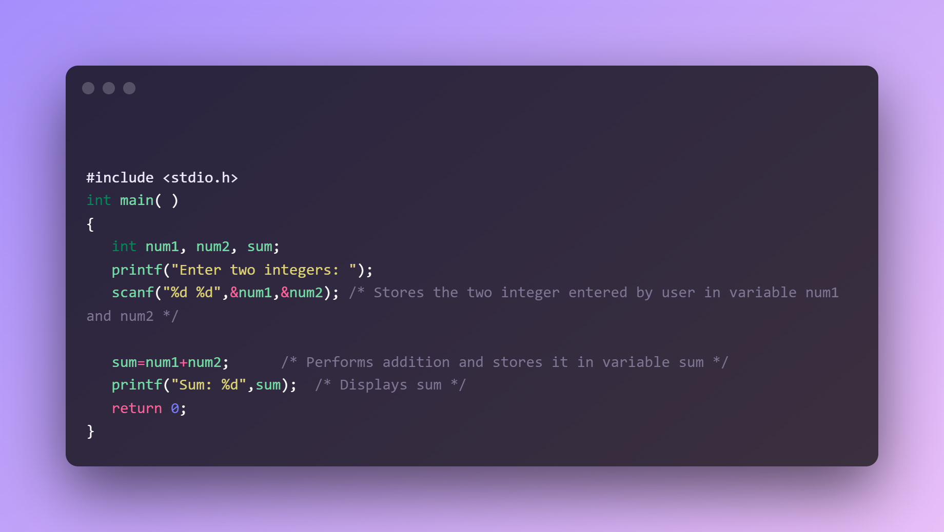
To add two numbers in a C programming language

Slide 7
C Programming language uses
It is used in Al programming, which is known as artificial intelligence programming.
build algorithms
Used in video game programming, such as Duty, Far Cry, and Call of Duty.

Slide 8
C Programming language uses
It is used in the programming and design of blockchain applications, and digital currencies: such as Ethereum and Bitcoin.
Programming for Mac and Windows Operating System

Slide 9
thanks
Printf(“thanks”);

